Slide 1
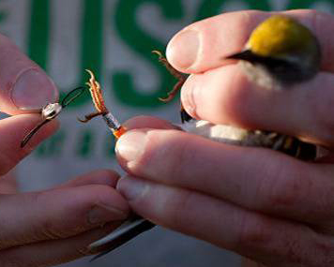
Figure-Eight Harness Design and Transmitter Attachment
Modifications by Streby et al. (2015) to methods
described by Rappole and Tipton (1991)

Slide 2
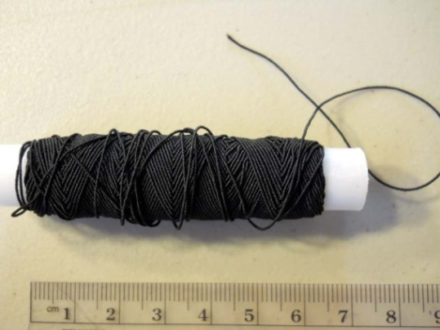
Harness material - We use elastic sewing thread that can be purchased at most sewing stores like Joann Fabrics.
Rappole and Tipton (1991) suggest catheter tubing or other “ligature material”.
We have found that elastic gives a nice amount of leeway for imperfect fitting due to individual size variation, and makes for an easier job of putting the transmitter on the bird and allows the transmitter to fall off, usually around 50 or 60 days after deployment.
Elastic also allows the harness to fit snugly without being too tight or limiting movement.
Elastic also allows for growth if you are putting transmitters on nestlings and plan to track them as fledglings.

Slide 3
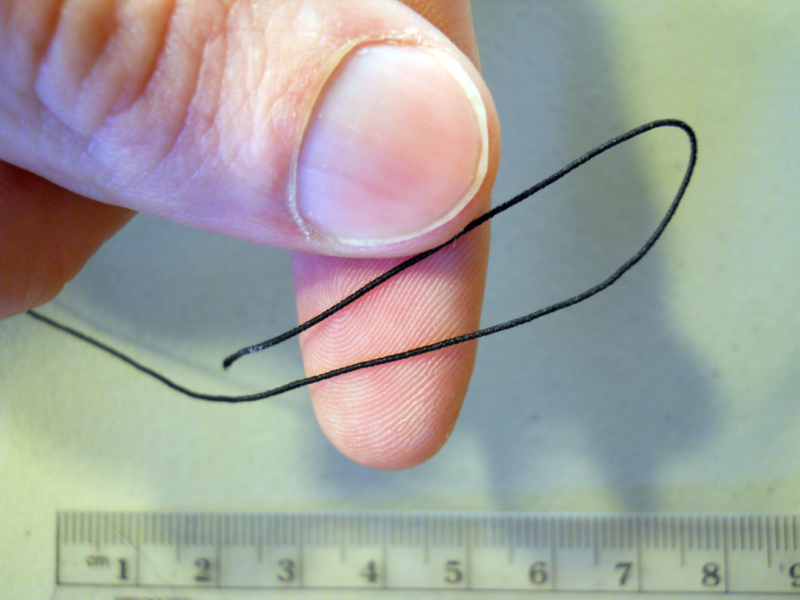
Making a Harness
Cut >10 cm of elastic thread (more for larger birds), and make a loop from ~1/3 of the segment, as shown.

Slide 4
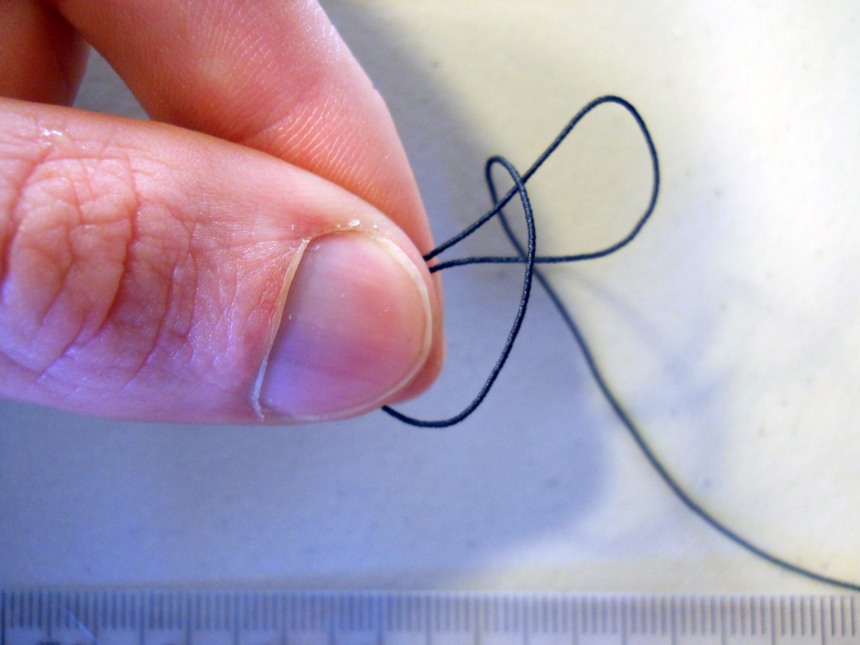
Making a Harness
Wrap the long end of the elastic around the loop

Slide 5
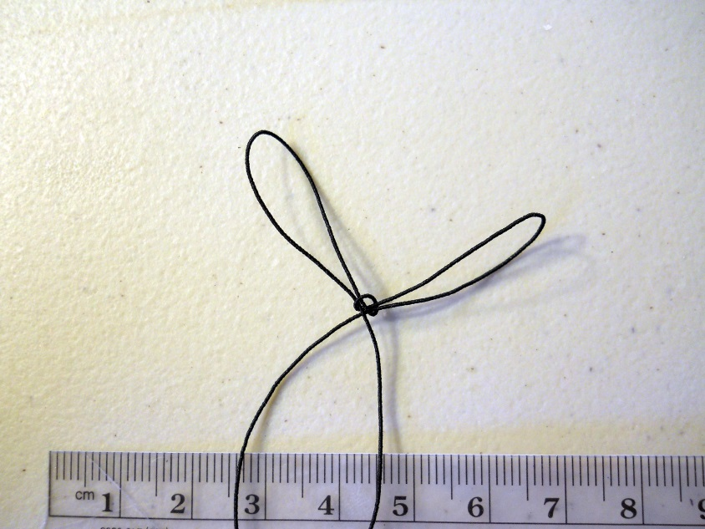
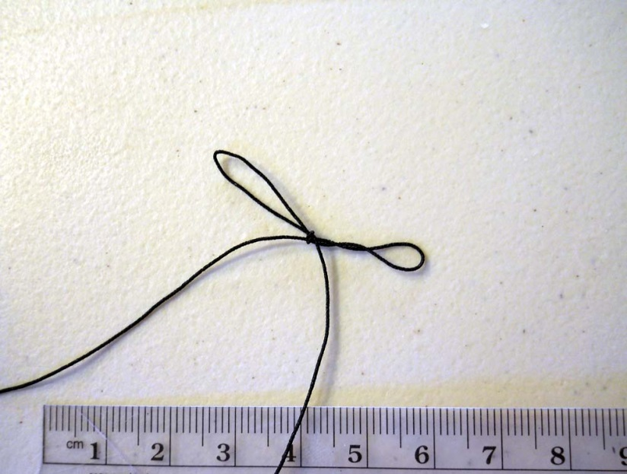
Making a Harness
Pull the long end through – basically, you are tying your shoes, and ending up with bunny-ears like below, left.
Leave the knot a little loose until you have adjusted the loops to approximately the correct length for your species. If you pull the knot tight and then try to adjust the loop length more than a little, you will get twisting in the loop (below right) which will cause issues when fitting the harness to the bird.
Adjust the loops to approximately the correct length (within a couple of mm), and then tighten the knot...

Slide 6
Making a Harness
Place the end of one loop around the end of a thin ruler. Use the ruler to measure the inside length of each loop (from end to knot) when the loop is pulled taught, but not stretched. Remove the harness from the ruler and adjust and re-measure each loop as necessary. About 22 mm fits Ovenbirds and 15 mm fits Golden-winged Warblers and Blue-winged Warblers.
Determining loop size will require field trials. Depending on the elasticity of the thread you use, the measurements may be different. You can put harnesses of several potentially correct sizes on something less expensive than a transmitter, then capture a few birds of your study species, and see which fits best.

Slide 7
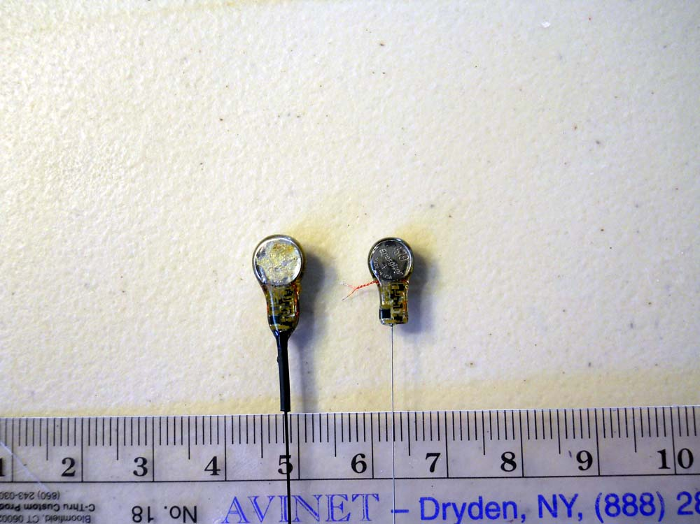
Transmitters
We attach the harness in the same place regardless of transmitter type, but here are a couple of example transmitters we’ve used for Ovenbirds and Golden-winged Warblers.
Both from Blackburn Transmitters (Nacogdoches, TX)

Slide 8
If your transmitters have loose wire leads that require soldering to activate the transmitter (saving the mass of an internal magnet), bend those leads up around the battery to get them out of the way.
You can solder the leads and glue them down before attaching the harness, but then the transmitter is running from that point on. We attach the harness ahead of time and then solder and glue down the leads in the field early on the day of deployment to maximize battery life. If you do this, be very careful not to touch the harness with the soldering iron. Melting the harness is a very frustrating event you hopefully won’t experience.

Slide 9
The magnet (not shown) on the transmitters we used, came wrapped in tape around the transmitter here.
If your transmitters use a magnet that is removed to activate the transmitter, remove the magnet, attach the harness, and put the magnet back in place. Before doing this, place some of the harness material between the transmitter and the magnet and make sure the magnet can still turn the transmitter off. This may take some individual adjustment depending on your transmitters.

Slide 10
NOT Here
Here
Place a bead of glue on the midline of the bottom (side that goes against the bird) of the transmitter between the battery and the transmitter.
This is where the harness will attach to the transmitter. It is important to NOT attach the harness too close to the end of the battery (see image), which could allow the transmitter to flip up and probably affect the bird.

Slide 11
Place the knot on the dab of glue with the loops perpendicular to the transmitter. Let the glue dry.
If the loops are at any other angle, the antenna will angle off-center, which might affect the bird.

Slide 12
Flip the transmitter over.
Place another bead of glue on the top of the transmitter.
Wrap the loose ends of the harness around the transmitter and across the bead of glue.
Note: We use a gel superglue for all of this. It allows you to make a dab or bead instead of coating an area with a thin layer.

Slide 13
Cut the loose ends of the harness.
Note: if your transmitters have the frequency displayed on the surface, make sure you write it down before you cover it up with the harness.

Slide 14
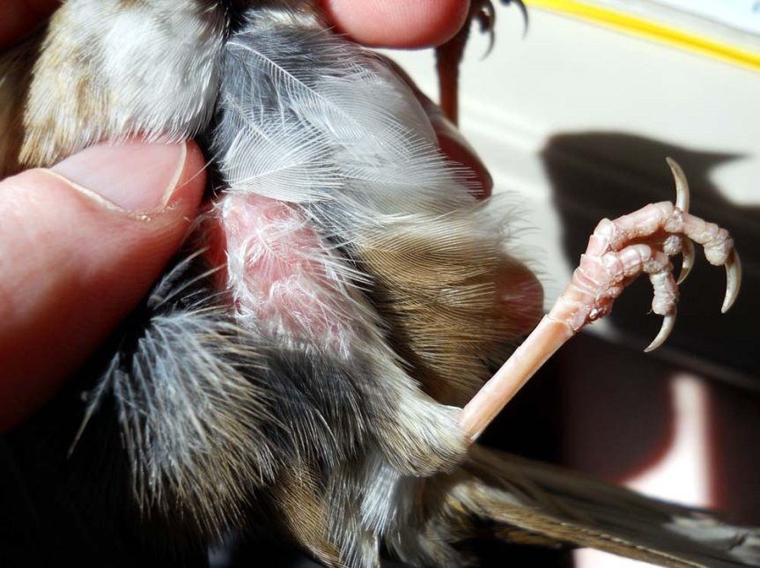
To put the harness on the bird, follow the directions in our manuscript and those in Rappole and Tipton (1991). Slide one loop over one foot and move the loop up the leg until it is snug against the body (between the thigh and the body). Then pull the transmitter around the back of the bird (under the wings), and rest the transmitter on the lower back. Then pull the other loop around the other leg. It works best to pull that second loop over the tibiotarsal joint, then over the toes, and finally over the knee.
If you are putting transmitters on nestlings, it can be helpful to place a very small
dab of skin-safe glue on the harness loop between the leg and the body. Nestlings tumble around in the nest, and they can occasionally wriggle out of the harness before fledging.

Slide 15
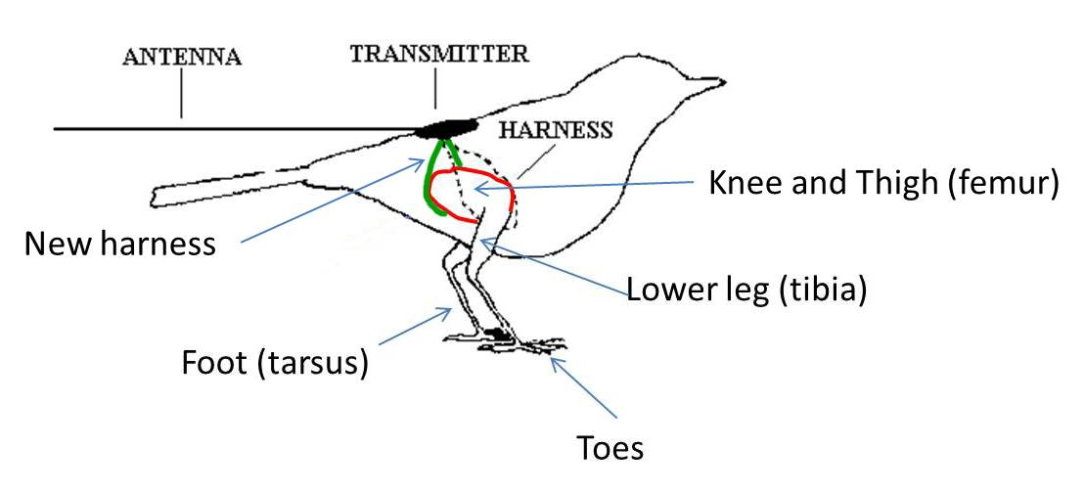
Harness Placement
Figure 1 from Rappole and Tipton (1991) gives the impression that the harness (dotted black line below) fits somewhat loosely around the knee or maybe the lower leg. We modified that figure here to demonstrate where the harness (green) should go up around the thigh (red).

Slide 16
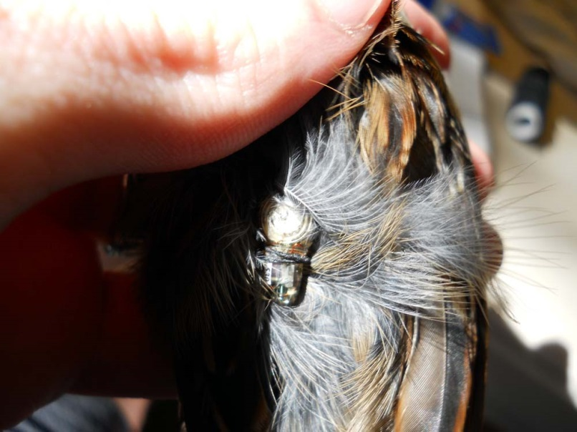
When you are done, the transmitter should fit snugly against the bird’s lower back (over the synsacrum).
If you can easily slide the transmitter forward and backward or side to side without stretching the harness, it is probably too loose.
If the harness pulls one or both of the bird’s legs out from under the body, it is too tight.
A little loose is better than too tight during trials. It is better to have the bird drop the transmitter than to be injured by it. This is where the elastic is helpful. You can have the harness stretch a little and fit snugly without restraining the bird’s movements.

Slide 17
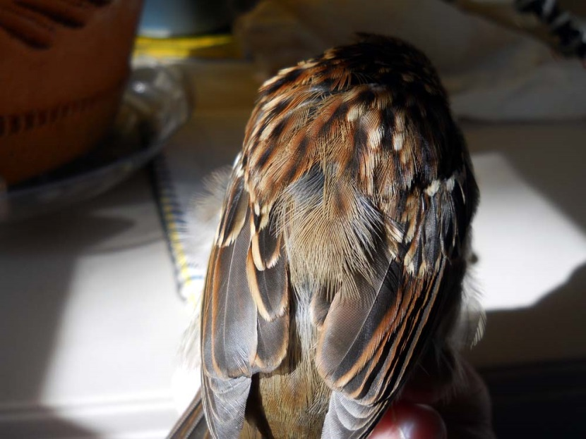
On adult birds, the transmitter can go under the feathers, and is barely visible but for the antenna sticking out beyond the tail.
For less feather displacement, the transmitter can be fitted over the feathers (see geolocator video for above feather methods).
On nestlings, there will probably not be enough feathers to cover the transmitter. Optionally, shiny transmitters can be painted to match feather color so there isn’t a nice shiny bulls-eye on the fledgling’s back for predators to find (this can work with adults too if you prefer above the feather placement..

Slide 18
Tips
Before you release a radio-marked bird, turn the bird over, blow away the feathers on the body and legs, and make sure both harness loops are up between the thigh and the body.
The first loop might slide down the leg while you work the second loop onto the second leg.
This can go on a checklist that is referenced every time you radio-mark a bird.
Another point for that checklist is to make sure the transmitter is transmitting. Make sure the magnet is off (or the solder didn’t break) by using a receiver to check for the signal before putting the transmitter on the bird, and again before releasing the bird. Releasing a bird with a non-functioning transmitter would be a very frustrating event.

Slide 19
Antenna Length
Another consideration is the length of the transmitter antenna. Even if the antenna is flexible and coated in non-kinking, non-stick material (as is desired), using the shortest antenna possible for your tracking needs is important to avoid potential vegetation tangling.
Take a transmitter or two to your study area or similar habitat and trim the antenna down bit by bit to find the minimum length you can use.
As with all marking activities, err on the side of animal safety; it is better to spend extra time searching for a wide-ranging bird then to lose a study organism to marker effects for want of better range.

Slide 20
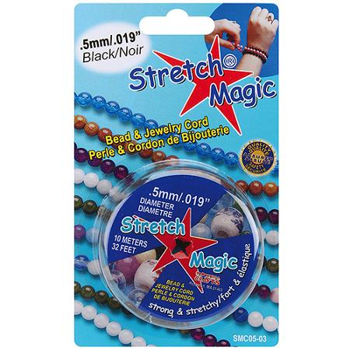
For Geolocators
The harness for a geolocator can be made using the same methods, but with jewelry cord instead of elastic sewing thread.
It takes a little practice to tie good knots with the jewelry cord.
Fitting the geolocator to the bird is slightly more complicated due to the limited elasticity of the jewelry cord (see video for geolocator attachment).

Slide 21
Questions?
Every study and every study species will be different. If you want to discuss details, please email:
Henry Streby: henrystreby@gmail.com.
Sean Peterson: sean.michael.peterson@gmail.com
Gunnar Kramer: gunnarrkramer@gmail.com

Slide 22
Citing These Methods
If you publish research in which you use these methods it is appropriate to cite these manuscripts:
Streby, H.M., T.L. McAllister, G.R. Kramer, S.M. Peterson, J.A. Lehman, and D.E. Andersen. 2015. Minimizing marker mass and handling time when attaching radio transmitters and geolocators to small songbirds. Condor: Ornithological Applications (in press, check Condor website for volume and page numbers).
Rappole, J.H. and A.R. Tipton. 1991. New harness design for attachment of radio transmitters to small passerines. Journal of Field Ornithology 62:335–337.
Please visit http://henrystreby.wix.com/research for papers reporting research using these methods and controlled comparisons demonstrating a lack of effects on marked birds.

